Slide 1


Structured Deep Learning for Video Analysis
Fabien Baradel
PhD Candidate
Advisors: Christian Wolf & Julien Mille
June, 29th, 2020
fabienbaradel.github.io

Slide 2
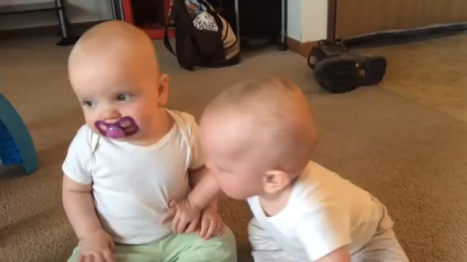
What is video understanding?
Human actions
Entity-level interactions
Temporal reasoning / Causality
Sitting on the floor
Grabing a silencer
The baby starts crying because of the silencer

Slide 3
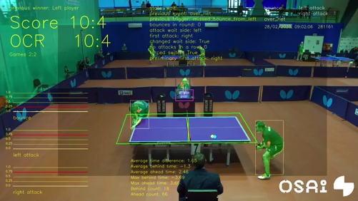

Why video understanding?
Indexing
Retrieval
Recommendation
Analysis
Human-robot interactions
[TTNET, CVPRW’20]

Slide 4

A video understanding task Action Recognition
CV system
walking
Classification task
Pre-defined labels
Similar to object recognition
[HMDB, Kuehne, ICCV’11]

Slide 5
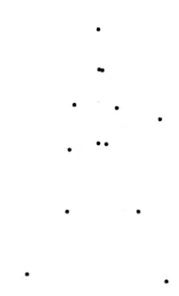
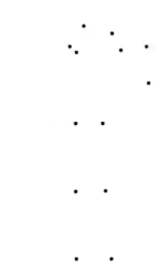
Human Pose
Walking
Pose is enough
Chopping
What is being chopped?
[Johansson, 1973]

Slide 6
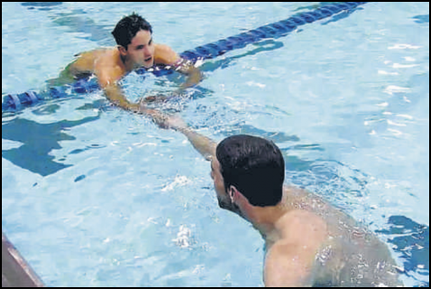


Context & Appearance
Swimming?
Handshaking

Slide 7
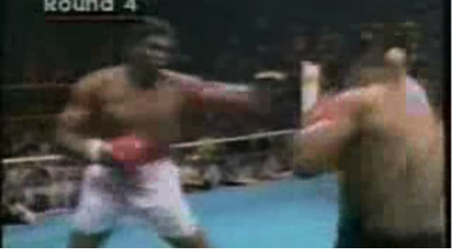
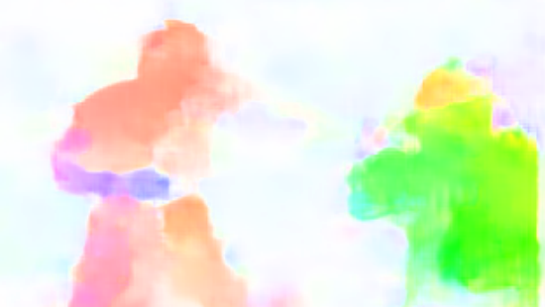
Action Recognition Recent works
Two-stream
I3D
CNN
Appearance
CNN
label
label
Video
CNN
Video
Motion
3D
2D
kernel
2D
inflated kernel
Limitations
Biased towards context
Lack of explainability
Human pose? Objects? Scene?
[Two-stream, Simonyan, NIPS’16]
[I3D, Carreira et al, CVPR’18]

Slide 8
Structured Deep Learning

Slide 9
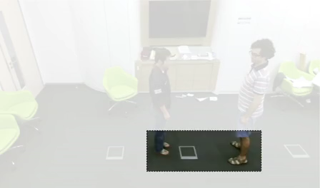
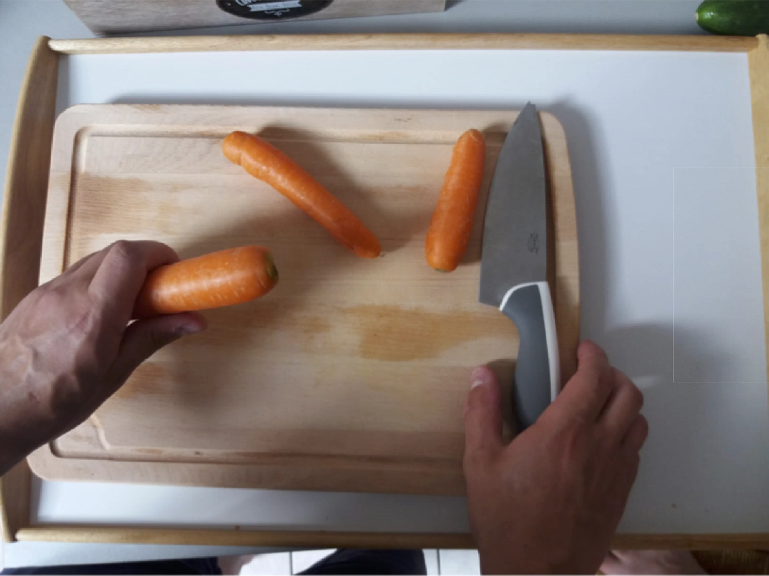
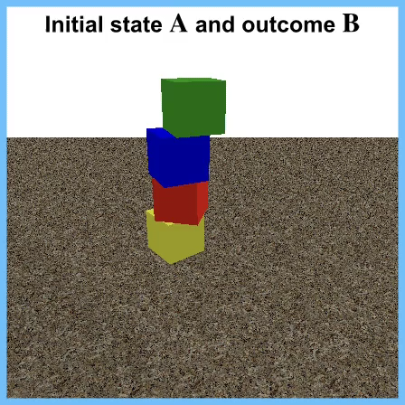



Outline
Visual Attention
« Glimpse Clouds »
F. Baradel, C. Wolf, J. Mille, G. Taylor
CVPR'18
Entity-level interactions
« Object level Reasoning »
F. Baradel, N. Neverova, C. Wolf,
J. Mille, G. Mori
ECCV'18
Reasoning
« Counterfactual learning »
F. Baradel, N. Neverova, J. Mille, G. Mori, C. Wolf
ICLR’20 (spotlight)
Christian Wolf
INSA Lyon - LIRIS
Julien Mille
INSA CVL - LI Tours
Graham W. Taylor
University of Guelph
Vector Institute

Slide 10
Visual Attention
What is happening?
Winter activities
[Yarbus, 1976]
[Roger et al, 2012]

Slide 11
Visual Attention
What is Charlie doing?
Walking
[Yarbus, 1976]
[Roger et al, 2012]

Slide 12
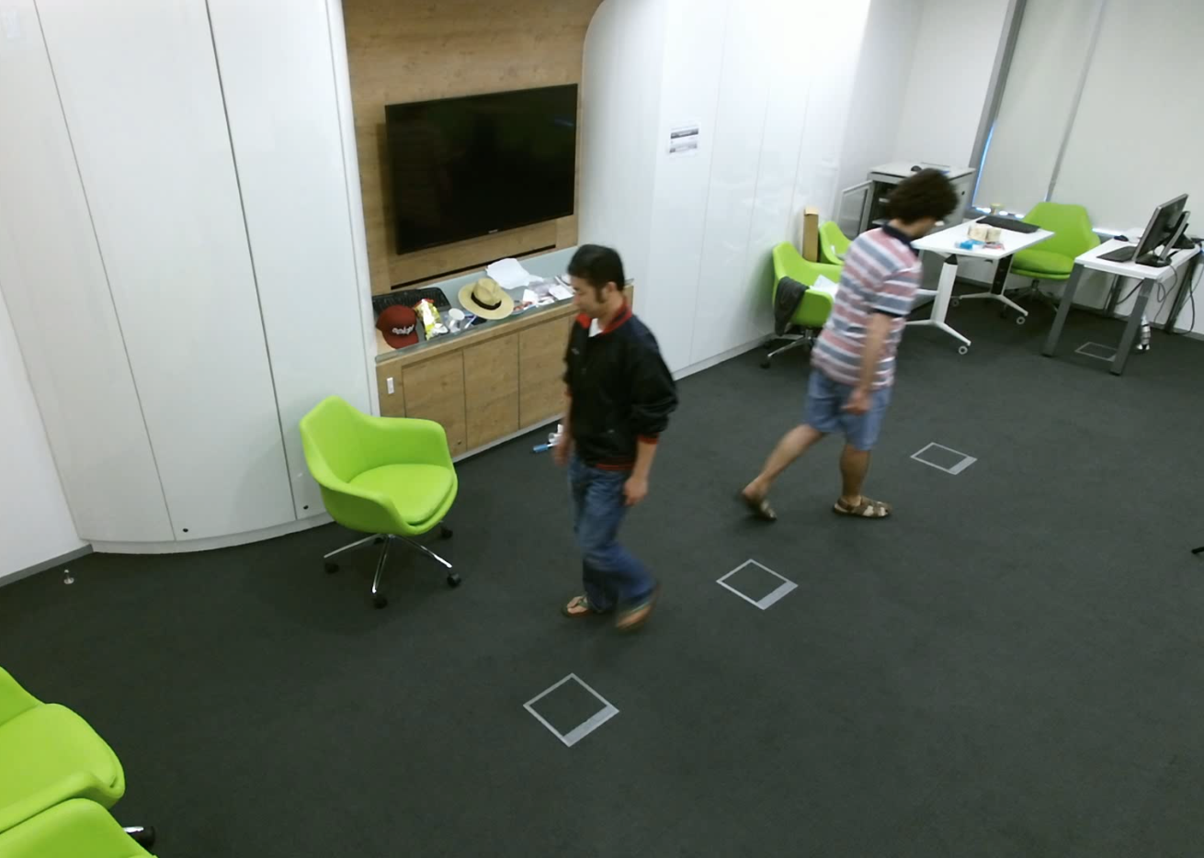
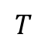

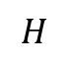
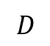
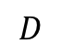
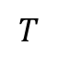
Action Recognition Baseline
$$T$$
$$T$$
$$D$$
pooling
classifier
label
R3D
$$H$$
$$W$$
$$D$$
Video
Feature map
Limitations
What about fine-grained human actions?
How to focus on relevant parts of the video?

Slide 13
Glimpse Clouds Method
context
$$T$$
human pose
Loss
Maximize distance between glimpses
Good human pose estimation
Cross-entropy loss
R3D
RNN
N concepts
External memory
Video
t=1
Worker 1
label
…
soft
assignment
…
Local features
t
…
Worker N
label
t=T
[Recurrent Visual Attention, Mnih et al, NIPS’14]
[3D Resnet, Hara et al, CVPR’18]

Slide 14
Glimpse Clouds State-of-the-art results
Method | Modality | CS | CV
Ensemble TS-LSTM | skeleton | 74.6 | 81.3
View invariant | skeleton | 80.0 | 87.2
Hands-Attention (ours) | skeleton+ RGB | 84.8 | 90.6
Glimpse Clouds (ours) | RGB | 88.4 | 93.2
Method | Modality | V1
Enhanced viz. | Skeleton | 86.1
Ensemble TS-LSTM | Skeleton | 89.2
NKTM | RGB | 75.8
Glimpse Clouds (ours) | RGB | 90.1
Accuracy on NTU-RGB+D
Accuracy on Northwestern-UCLA
fabienbaradel/glimpse_clouds
[Pose-driven hands-attention, Baradel et al, BMVC’18]

Slide 15
Glimpse Clouds Ablation study
+1.9
+4.4
Resolution matters
Local fine-grained features

Slide 16
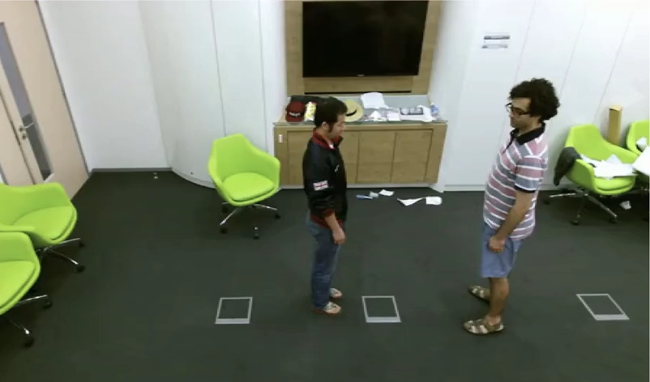
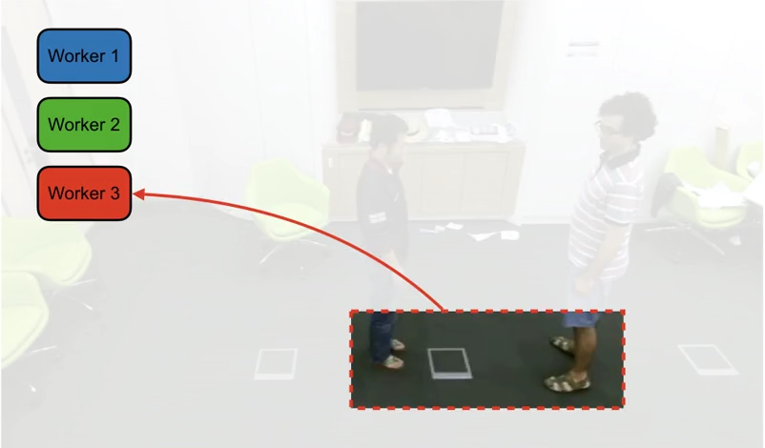
Glimpse Clouds Visualization
Raw video
Attended regions
Worker 1 → ~Hands
Worker 2 → ~Heads
Worker 3 → ~Legs
Note: argmax shown for the feature-to-worker association

Slide 17


Outline
Unstructured local features…
Incorporate structure from images?
Leverage visual entities interactions?
Visual Attention
Entity-level interactions
« Object level Reasoning »
F. Baradel, N. Neverova, C. Wolf,
J. Mille, G. Mori
ECCV'18
Christian Wolf
INSA Lyon - LIRIS
Julien Mille
INSA CVL - LI Tours
Natalia Neverova
Facebook
Greg Mori
SFU

Slide 18

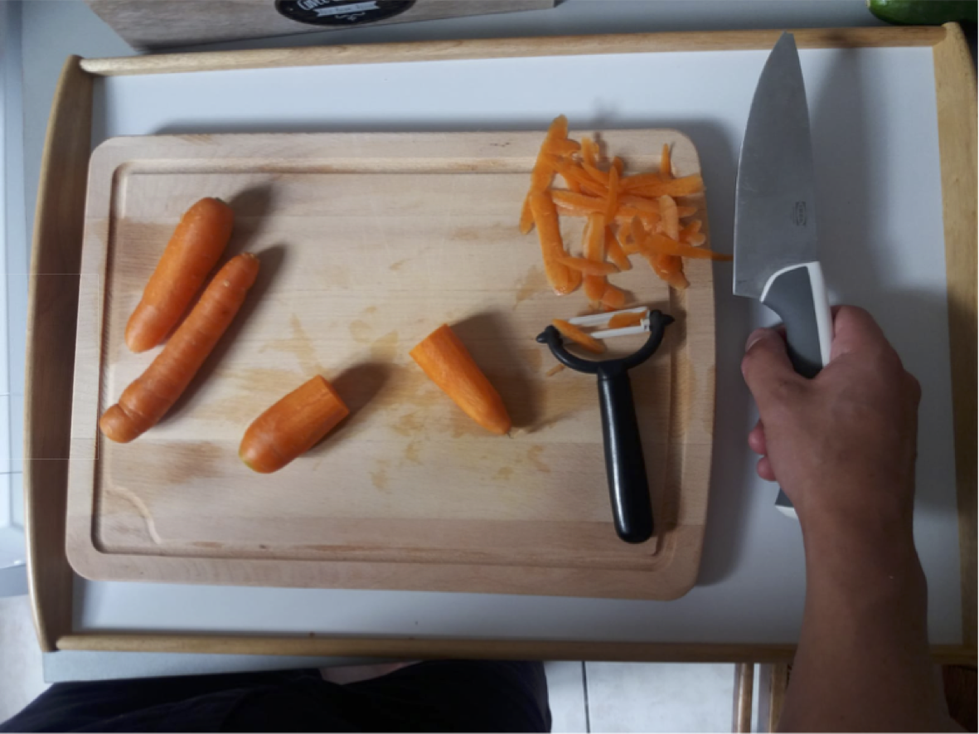
Object-level Reasoning
time
Action
Often possible to infer what happened from few frames

Slide 19
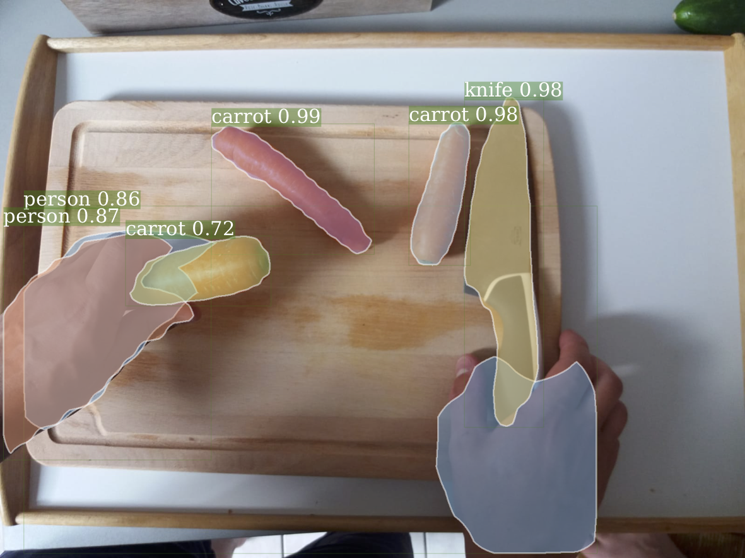
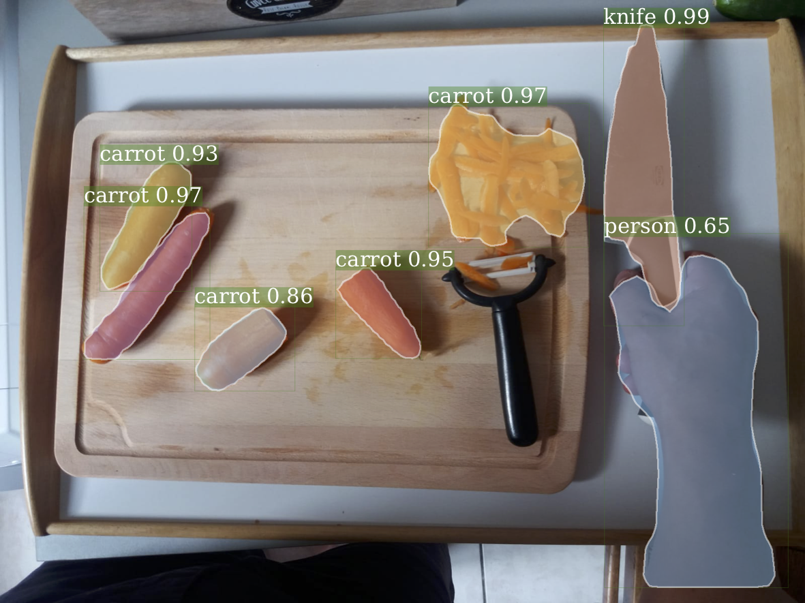
Object-level Reasoning
time
Action
Often possible to infer what happened from few frames
Visual entities interactions
[Mask-RCNN, He et al, ICCV’17]

Slide 20
Image as a set of objects
Set
attributes
appearance
shape
semantic
RGB
Mask-RCNN
CNN features
pixel location
COCO class

Slide 21
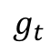

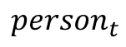
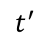
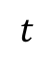
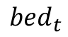
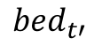
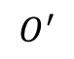
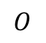
Object Relation Network
$$t^{′}$$
$$t$$
$$O^{′}$$
$$O$$
$${person}_{t}$$
$${bed}_{t′}$$
Graph creation
$${bed}_{t}$$
$$𝔖$$
How?
Structure?
Clique size?
Type of interactions?
[GCN, Kipf et al, ICLR’17]
[Graph Networks, Battaglia et al, arXiv’18]
$$g_{t}$$

Slide 22
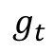
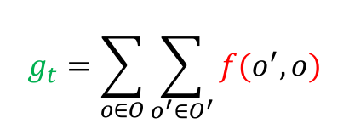

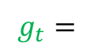
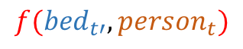
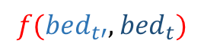
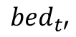
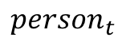
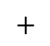
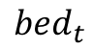
Object Relation Network
$$t^{′}$$
$$t$$
$$O^{′}$$
$$O$$
$${person}_{t}$$
$${bed}_{t′}$$
Graph creation
$${bed}_{t}$$
$$𝔖$$
$${person}_{t}$$
$${bed}_{t′}$$
$${bed}_{t}$$
Shared MLP
Data efficient
Invariant to the number of objects
Inter-frame object relations
Semantic meaning
Clique of size 2
$$g_{t}=$$
$$f({bed}_{t′},{person}_{t})$$
$$+$$
$$f({bed}_{t′},{bed}_{t})$$
$$g_{t}=\sum_{o∈O}{\sum_{o^{′}∈O^{′}}{f(o^{′},o)}}$$
[GCN, Kipf et al, ICLR’17]
[Graph Networks, Battaglia et al, arXiv’18]
$$g_{t}$$

Slide 23
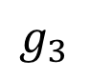
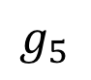
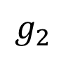
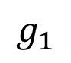
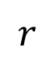
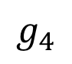
Object Relation Network
time
inter-frame
representation
$$g_{1}$$
$$g_{2}$$
$$g_{3}$$
$$g_{4}$$
$$g_{5}$$
RNN
object-level
video representation
$$r$$
Loss
Cross-entropy
linear
label

Slide 24
Object Relation Network State-of-the-art
Method | Acc.
C3D | 21.50
I3D | 27.63
Multiscale TRN | 33.60
Object Relation Network | 35.97
Method | mAP
Resnet50 | 40.5
I3D | 39.7
Object Relation Network | 44.7
Method | Acc.
Resnet18 | 32.05
Resnet3D-18 | 34.20
Object Relation Network | 40.89
Accuracy on Something-Something
Mean Average Precision on VLOG
Verb accuracy on EPIC Kitchens
+
fabienbaradel/object_level_visual_reasoning
Object masks detected by Mask-RCNN

Slide 25
Object Relation Network Ablation study
+4.8
+6.7
Detection performance
High resolution
+2.3

Slide 26
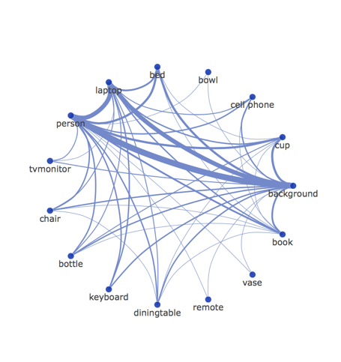
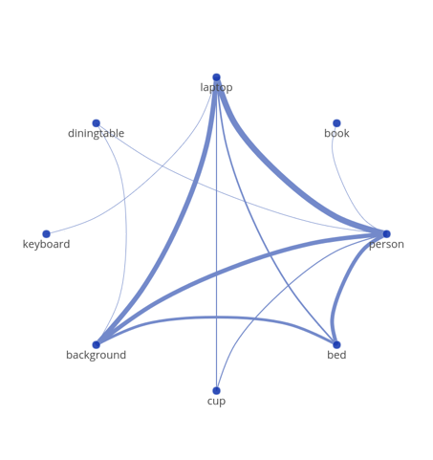
Object Relation Network Interactions
Spurious correlations
Co-occurences
Human-Laptop interactions
Learned relations

Slide 27
Outline
Structure matters…
Can we go one step further?
Beyond supervised learning?
Learning underlying latent concepts?
Visual Attention
Entity-level interactions
Reasoning
« Counterfactual learning »
F. Baradel, N. Neverova, J. Mille, G. Mori, C. Wolf
ICLR’20 (spotlight)
Christian Wolf
INSA Lyon - LIRIS
Julien Mille
INSA CVL - LI Tours
Natalia Neverova
Facebook
Greg Mori
SFU

Slide 28
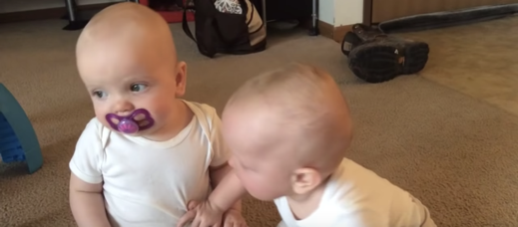
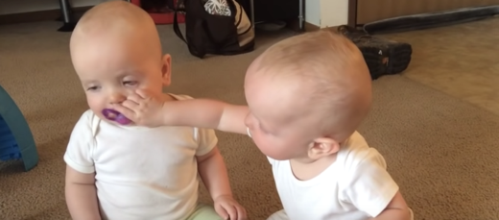
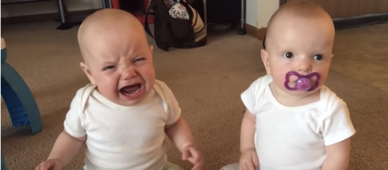
Reasoning & Causation
Latent
Concepts
Understanding of complex relationships
Cause-effect
What would happened if?
Counterfactual statement

Slide 29
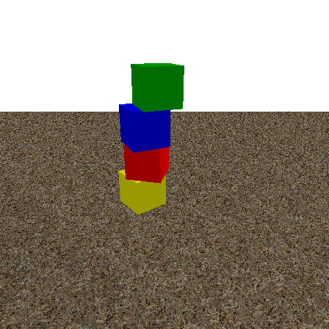







Counterfactual Future forecasting
$$A$$
$$B$$
Initial state
Outcome
Masses
Frictions
Gravity
$$C$$
$$D$$
Counterfactual
outcome
Modified
initial state

Slide 30














Counterfactual Future forecasting
Feedforward
Counterfactual
$$U$$
$$U$$
Confounder
Confounder
$$X_{0}$$
$$X_{1:τ}$$
$$X_{0}$$
$$X_{1:τ}$$
$$X_{0}$$
$$X_{1:τ}$$
$$A$$
$$B$$
$$A$$
$$B$$
$$do(X_{0}=C)$$
$$D$$
Initial state
Outcome
Initial state
Outcome
Modified initial state
Counterfactual outcome
[Algorithmization of counterfactuals, Pearl, arXiv’18]

Slide 31



CoPhy benchmark
Large-scale datasets
250k examples ((A,B), (C,D))
7 millions of frames
Supervision of the do-operator ( )
Confounders are necessary for future prediction

Slide 32






CoPhyNet Unsupervised confounders estimations
time
$$A$$
GCN
Recurrent GCN
RNN
GCN
…
$$B$$
RNN
GCN
$$U$$
[GCN, Kipf et al, ICLR’17]

Slide 33
CoPhyNet Unsupervised confounders estimations
time
$$A$$
Recurrent
GCN
Recurrent
GCN
$$B$$
…
Recurrent
GCN
$$U$$
[GCN, Kipf et al, ICLR’17]

Slide 34







CoPhyNet Trajectory prediction
time
$$C$$
Recurrent GCN
whether-cause
[:]
$t=$1
how-cause
$$D$$
Recurrent GCN
[:]
$t=$2
$$U$$
…
…
$t=$T
[Perceived-causality, Gerstenberg et al, ACCSS’15]

Slide 35



Human study
$$C$$
$$(A,B)$$
$$C$$
?
?
Human non-CF
Human CF

Slide 36
Cophynet Results
NOT COMPARABLE!
Copying baselines
Feedforward models
Soft-upper bound
Train → Test | Copy C | Copy B | IN | NPE | CoPhyNet | IN Sup.
3 → 3 | 0.470 | 0.601 | 0.318 | 0.331 | 0.294 | 0.296
3 → 3* | 0.365 | 0.592 | 0.298 | 0.319 | 0.289 | 0.282
3 → 4 | 0.754 | 0.846 | 0.524 | 0.523 | 0.482 | 0.467
Unseen confounders
Unseen number of blocks
MSE on 3D positions (average over time)
+
fabienbaradel/cophy
[Interaction Network, Battaglia et al, NIPS’17]
[Neural Physic Engine, Chang et al, ICLR’17]
CoPhy benchmark

Slide 37
Conclusion
Visual Attention
« Glimpse Clouds »
F. Baradel, C. Wolf, J. Mille, G. Taylor, CVPR'18
Focus on important parts
Automatic selection
Distributed recognition
Entity-level interactions
« Object level Reasoning »
F. Baradel, N. Neverova, C. Wolf,
J. Mille, G. Mori, ECCV'18
Object-centric modeling
Intra-time interactions
Learned relations
Reasoning
« Counterfactual learning »
F. Baradel, N. Neverova, J. Mille,
G. Mori, C. Wolf, ICLR’20 (spotlight)
Unsupervised latent discovery
Future trajectory
New task in visual space

Slide 38

Other works Pose-driven Attention
« Focus to Hands»
F. Baradel, C. Wolf, J. Mille, ICCVW’17
Skeleton & RGB
Handcrafted/Learned context features
Focus around hands
« Pose-driven Attention to RGB»
F. Baradel, C. Wolf,J. Mille,
BMVC’18

Slide 39




Other works Self-supervised learning
Human learning
Beyond large-scale annotated datasets
Efficient
Discover regularities
Prediction of missing parts
Instructional videos
Vision-Text alignment
« Contrastive Bidirectionnal Transformer »
C. Sun, F. Baradel, K. Murphy, C. Schmid
Under review ECCV’20
Cordelia Schmid
INRIA – Google
Chen Sun
Google
Kevin P. Murphy
Google

Slide 40
What next? Real word counterfactual predictions
« CoPhy++ »
F. Baradel, N. Neverova, J. Mille,
G. Mori, C. Wolf
To be submitted to TPAMI
No object supervision
Unsupervised keypoints
Predictions in image space

Slide 41

What next? Real word counterfactual predictions
What if?
Beyond correlation and dataset biases
Latent concept
Generalization
Semantical structure
Ontology

Slide 42


What next? Disentangled representation
Image vs Video
Appearance vs Motion
Human Object Interaction vs Long-range activities
Efficient representation

Slide 43
Thank you!
Christian Wolf
INSA Lyon - LIRIS
Julien Mille
INSA CVL - LI Tours
Natalia Neverova
Facebook AI Research
Graham W. Taylor
University of Guelph
Vector Institute
Greg Mori
Simon Fraser University
Borealis AI
Cordelia Schmid
INRIA – Google
Chen Sun
Google
Kevin P. Murphy
Google

